Slide 1
A disappearing A- Pillar
Crazy Pillar 1.1.4
Website: https://sdmay18-20.sd.ece.iastate.edu
Group members: Yixuan Wang, Han Liao, Wenrui Wu, Yaowei Lee, Guantong Zhou, Shengliang Liu
Professor name: Jaeyoun Kim

Slide 2
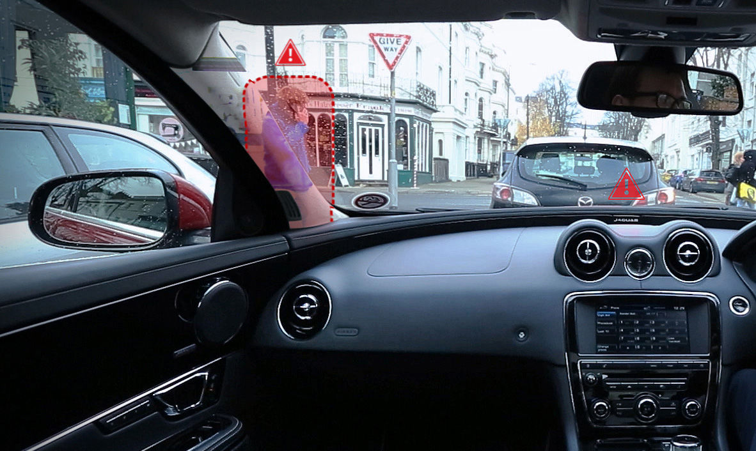
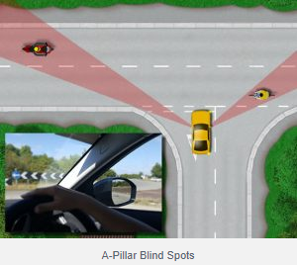
Problem statement:
The goal of our project is to render the A-pillar “transparent” through the camera,display, and computation of inexpensive tablets.
Drivingtesttips.com
Drivingtesttips.com
Notes:
Our project serves to provide a remedy to this problem by increasing the peripheral vision range of the driver.
The images captured are then displayed on the screen of the tablet which is attached to the A pillar, so that driver can “see through” the A pillar and avoid accidents.
The most fundamental part of our project would be to transfer the image from camera to the tablet

Slide 3
Problem statement: Background Info
Based on accident statistics for the year 2014, there were 3,401 seriously injured cyclists and 113 fatalities.
A study has found that the number of crashes caused by blind spots has increased by 50% over the last two years.(Motoring news)

Slide 4
Conceptual Sketch
Affix tablet onto the A-pillar to visualize the region obstructed to increase the peripheral vision range of the motorist.
Develop an App using Android Studio to transfer the images acquired from the camera to the screen seamlessly in real time.

Slide 5
Demonstration

Slide 6
Functional Requirements
Tablet(hardware):Nexus7
App development(software):
Camera activity: Zoom in\out, block size.
Customized: Input the default size of the pillar.
Pillar category: Allows users to choose the pillar size of their car.

Slide 7
Non Functional Requirements
The size of the tablet are supposed to suitable for the wide of A pillar.
Contract us: our introduction and contact information.
About product: project statement, purpose and design
App can work at the speed below 10 miles

Slide 8
Technical Consideration
Use java on android studio to develop an app to make drivers can see the outside view through A pillar.
We need to develop the camera class by ourselves since the Java version can only be used though the latest edition camera function -camera2

Slide 9
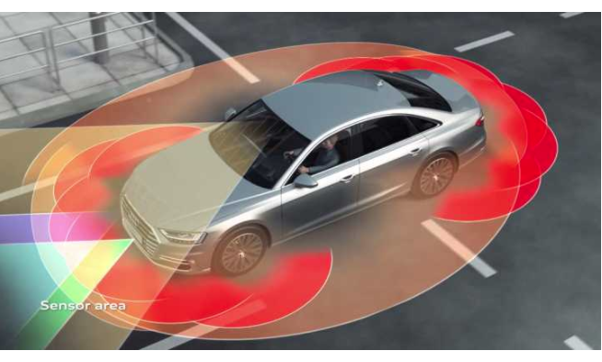
market survey
Corner radar and rear radar

Slide 10
Market Survey
Low cost
No extra device need(Andriod)
The App is convenient to use
We have the user guideline.
Suitable for all kinds of car
Pillar category function included
Available to customized the pillar width and length
Block size is allowed to be customized.
The camera can zoom in/out depend on the distance
We have this particular function to zoom.

Slide 11
Cost Estimate
Android 6.0 Marshmallow
No additional cost if you have an android tablet

Slide 12
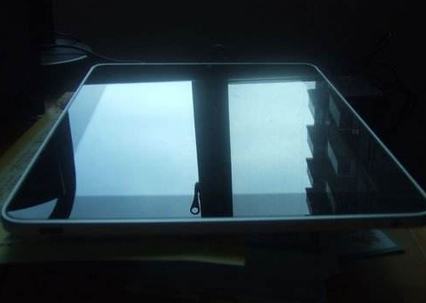
Potential Risks
In sunshine day, driver cannot see screen due to the reflection.
Cannot recognize the things that are very close to car.
Sometimes the tablet might drop off from the window.

Slide 13
Application Feedback
“I used this app on my car for a week, I think it basically achieved the aforementioned function in product description. But my device kept running out of battery in two hours. Hope the app developer can figure out this problem. I am really looking forward to releasing it in Google store”.
-- Wenrui Wu (team tester)
“I think this App is really convenient to use. I can see the outside view through A pillar clearly. and the image quality is good, but there is a slight delay with image display and it definitely can be improved more precise. I highly recommend this app to any driver who are looking for this particular function.”
-- Jiancheng Zhang

Slide 14
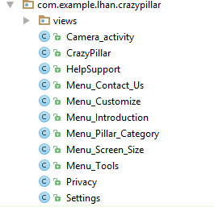
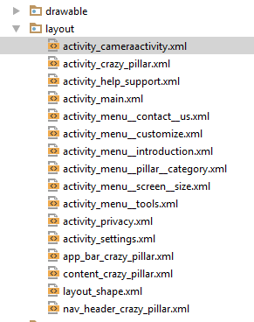
Functional Decomposition
Java doc
Xml doc

Slide 15
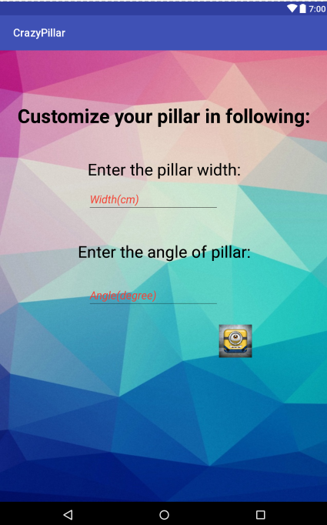
Detailed Design(Customize)
Menu_Customize class
Menu_Camera_activity class
Menu_CutomeView
protected void onCreate(Bundle savedInstanceState)
Intent intent=new Intent(Menu_Customize.this, Camera_activity.class);
intent.putExtra("rwinput",rwinput);
intent.putExtra("rainput",rainput);
startActivity(intent);
if (getIntent() != null && getIntent().getExtras() != null){
size=Integer.valueOf(getIntent().getStringExtra("rwinput"));
angle=Integer.valueOf(getIntent().getStringExtra("rainput"));
CustomeView customeView=new CustomeView(this);
mcustomView=(CustomeView)findViewById(R.id.customView) ;
mcustomView.changeSize(size,angle);
}
public void changeSize(int width,int angle){
Width=width*100;
Angle=angle;
cos=(float) (Math.cos(Math.toRadians(Angle)));
}

Slide 16
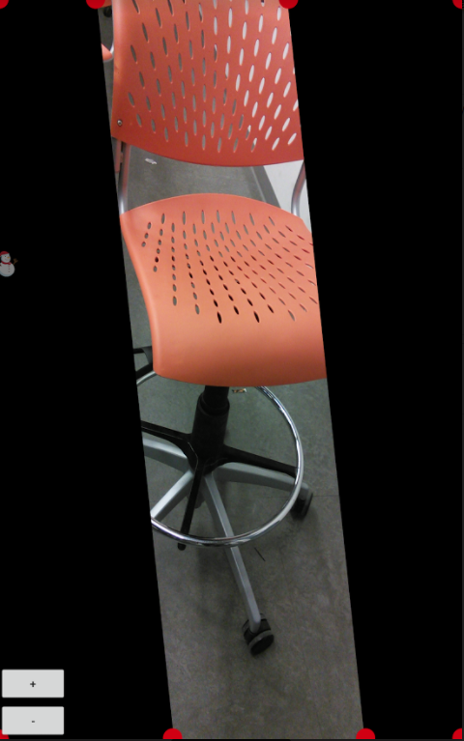
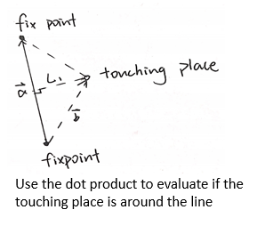
Detailed Design(Block size layout)
Step1: Evaluate if the area touched is around the line.
Step2: Depending on the movement of fingers, the blocks will pulled to left or right.
Step 3: Create a new CustomeView.
Step 1: Evaluate if the touch place is around the circle
Step 2: Depend on the finger position, move the red circle to a certain place.
Step3: Create a new CustomeView.
public boolean onTouchEvent(MotionEvent event)
public void onDraw(Canvas canvas)

Slide 17
Detailed Design(Camera)
Permission from android manifest
On touch to zoom
Close camera
Connect Camera
Start preview
Set up Camera
Start Still Capture Request

Slide 18
Prototype Implementations
Customized width and angle
Zoom in/out
Customizable block

Slide 19
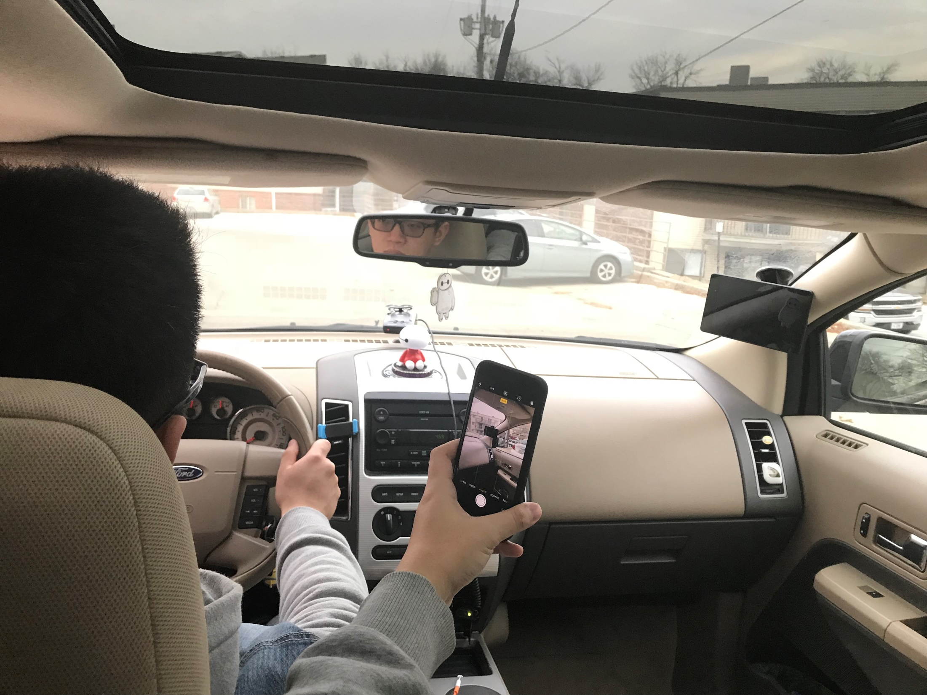
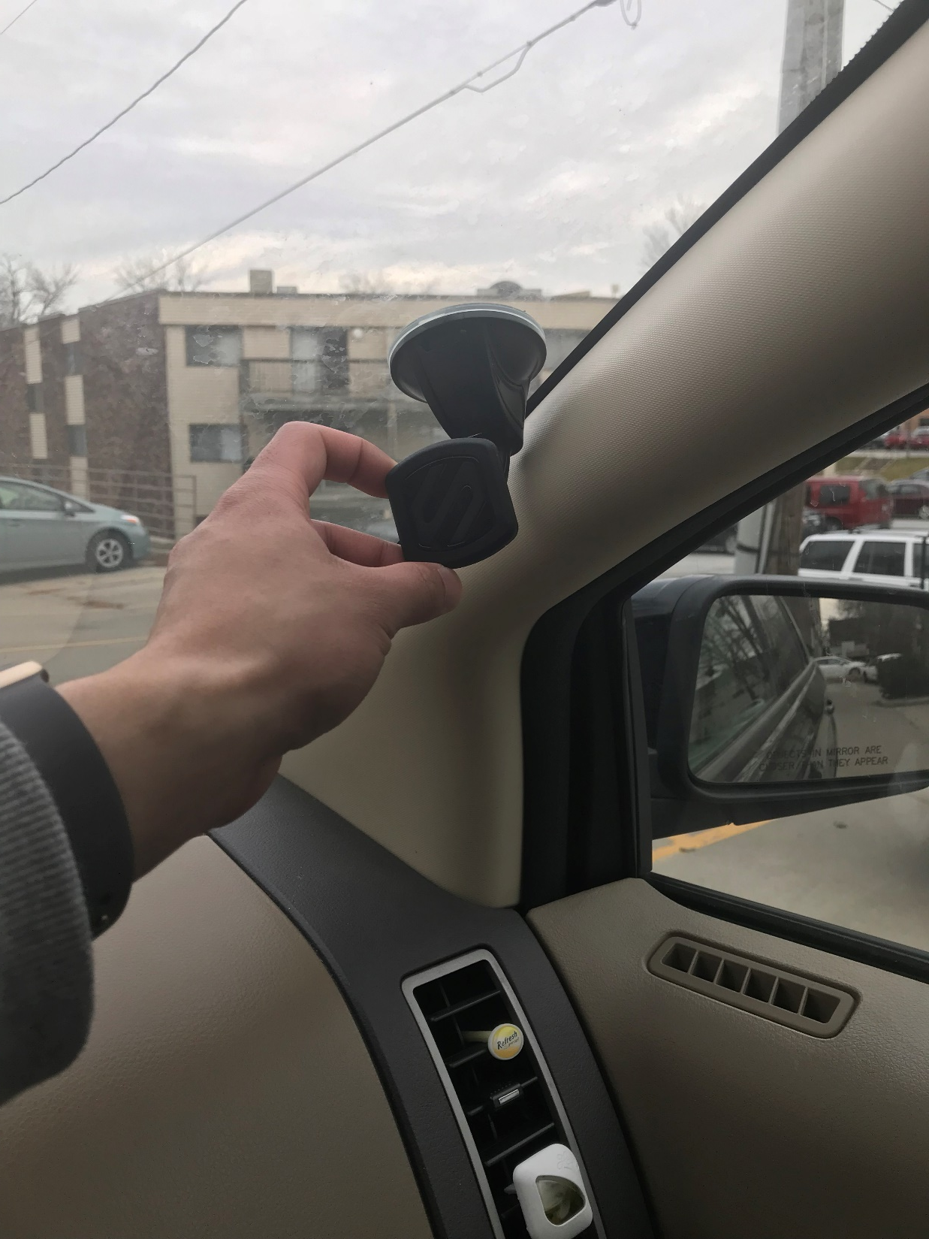
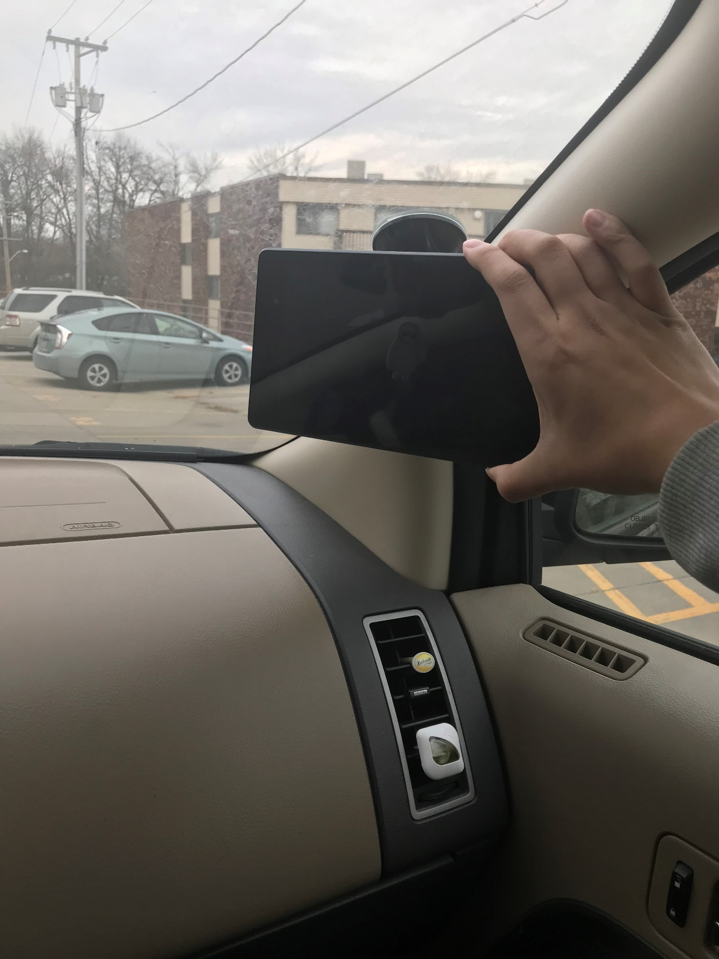
Test Plan
Step 1:
Test car(Ford Edge) and tester
Step 2:
Affixed magnetic holder onto the windscreen to hold the tablet
Step 4:
A video is recorded while the vehicle is moving from the driver’s view.
Step 3:
Tablet is attached onto
The A-pillar.

Slide 20
Technology platform
Android studio 2.3.3
Android 6.0 Marshmallow
Nexus 7.0

Slide 21
Contribution on main function:
Yixuan Wang | Zoom in/out\\Camera function\\Contact us\\Pillar category
Wenrui Wu | Zoom in/out\\Camera function\\Contact us\\Pillar category
Guantong Zhou | Zoom in/out\\Camera function\\Pillar category
Han Liao | Block size\\Camera function\\customize\\Contact us\\Pillar category
Yaowei Lee | Block size\\Website\\Camera function\\Document submitting\\Pillar category
Shengliang Liu | Block size\\Camera function\\Pillar category

Slide 22
Schedule:
Aug 20-Aug 31 User interface frame
Sep 1-Sep 15 Contact us function
Sep 16-Sep 29 Customizable block size
Oct 1-Oct 20 Camera activity
Oct 20 – Nov 13 Touch controllable block size
Nov 14 – Dec 1 Zoom in/out function

Slide 23
Conclusion:
Overall, this was a challenging project for us to undertake due to the fact that our programming knowledge was fairly basic. We spent a good amount of time at the start of the semester figuring out how to work with Android Studio. Our goal for this project is to render the A-pillar invisible and to be able to see the region obstructed by the A-pillar. I can safely say that we have achieved this milestone. We will work on improving the workability of the functions already available in the App, such as the zoom/in function, image quality, and block size.

Slide 24
Plans for next semester:
Improve the image quality.
Finish the “user privacy” function
Finish the “tools” function
Improve the art/design of the App
Improve gesture operation and make it more accurate
Reduce the delay time

Slide 25
Reference
https://www.drivingtesttips.biz/driving-test-tutorials/a-pillar-blind-spots.html
http://www.motortrend.com/news/2016-ces-tech-highlights/
https://www.youtube.com/watch?v=lbrA3K7P8vg
https://www.youtube.com/watch?v=KLunXJxd9-g
https://www.youtube.com/watch?v=zTZrDEhmPd4
https://www.androidauthority.com/android-studio-tutorial-beginners-637572/
http://techtrickz.com/how-to/unofficial-aosp-android-6-0-marshmallow-available-for-nexus-s-installation-guide/
https://www.xda-developers.com/push-your-nexus-7-to-the-limit-with-elite-kernel/
https://www.youtube.com/watch?v=c98h41TkREA
https://www.zhihu.com/question/62307321/answer/242934910

Slide 26
Thank you!

